Slide 1
Ensemble Learning 学习分享
安思宇

Slide 2
Outline
Review of key concepts of supervised learning
Classification & Regression Tree
Ensemble learning, Random Forest & AdaBoost
Gradient Boosting(GBRT)
GBRT in action
Summary

Slide 3
Outline
Review of key concepts of supervised learning
Classification & Regression Tree
Ensemble learning, Random Forest & AdaBoost
Gradient Boosting(GBRT)
GBRT in action
Summary

Slide 4
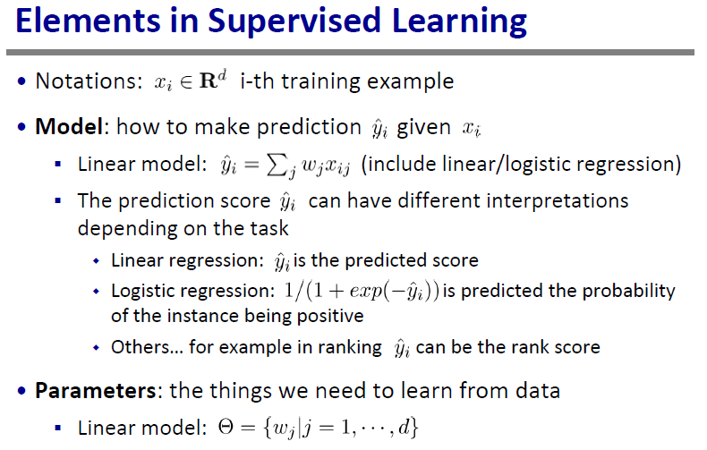

Slide 5
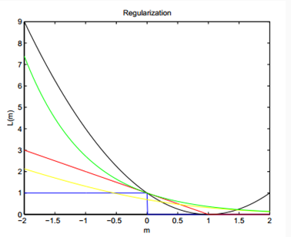
Which one is suitable for classification and regression?
Black：square loss
Green: AdaBoost loss
Red: hinge loss
Yellow: logistic loss
Suppose label = 1,
m:predict result,
L(m): loss function

Slide 6
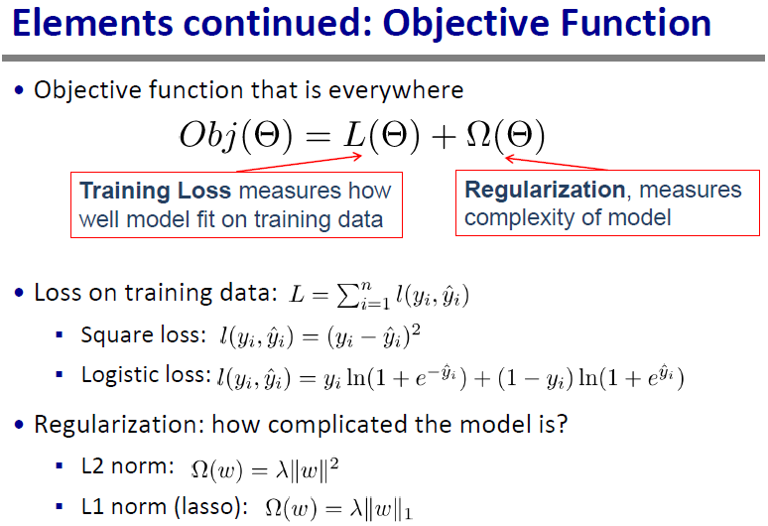

Slide 7
Outline
Review of key concepts of supervised learning
Classification & Regression Tree
Ensemble learning, Random Forest & AdaBoost
Gradient Boosting(GBRT)
GBRT in action
Summary

Slide 8

Decision Tree
以信息熵为度量递归地构建一棵熵值下降最快的树，叶节点熵为0
内部节点表示一个特征或属性
叶节点表示一个类别
建树：
ID3：信息增益$g\left(D,A\right)=H\left(D\right)−H(D|A)$，细分情况
C4.5：信息增益率$\frac{g(D,A)}{H(D)}$

Slide 9

CART(classification and regression tree)
分类
基尼系数：假设有K个类别，样本点属于第k类的概率为$p_{k}$，则概率分布的基尼系数为 $Gini\left(p\right)=\sum_{k=1}^{K}{p_{k}\left(1−p_{k}\right)}=1−\sum_{k=1}^{K}{p_{k}^{2}}$，基尼系数越大，样本集合的不确定性也越大
给定样本集D，基尼系数为($C_{k}$为D中属于第k类的样本子集)
Gini(D) = 1-$\sum_{k=1}^{K}{{\left(\frac{\left|C_{k}\right|}{\left|D\right|}\right)}^{2}}$
在特征A的条件下，集合D的基尼系数定义为
$$Gini\left(D,A\right)=\frac{\left|D_{1}\right|}{\left|D\right|}Gini\left(D_{1}\right)+\frac{\left|D_{2}\right|}{\left|D\right|}Gini(D_{2})$$

Slide 10
CART(classification and regression tree)
建分类树：
遍历所有的特征和所有的切分点（特征的所有取值 ），在所有可能的特征以及所有特征的所有可能的切分点中，选择基尼系数最小的特征及其对应的切分点作为最优特征与最优切分点
递归建树，启发式方法不断将训练数据集特征依次分配到子节点中

Slide 11

CART(classification and regression tree)
回归
回归树模型可以表示为$f\left(x\right)=\sum_{m=1}^{M}{f_{m}(x)}$
可以用平方误差$\sum_{x∈R_{m}}{{(y_{i}−f(x_{i}))}^{2}}$表示回归树对于训练数据的预测误差，用平方误差最小的准则求解每个单元上最优输出值
选择第j个变量$x^{j}和$它的切分点取值s，定义两个区域
$R_{1}\left(j,s\right)=\left\{x | x^{\left(j\right)}≤s\right\}$和$R_{2}\left(j,s\right)=\{x|x^{\left(j\right)}>s\}$

Slide 12

CART(classification and regression tree)
建回归树（启发式方法）
求解$\min_{j,s}{[\min_{c_{1}}{\sum_{x∈R_{1}}{{(y_{i}^{}−f_{1}^{})}^{2}+\min_{x∈R_{2}}{{(y_{i}^{}−f_{2}^{})}^{2}}}}]}$
对所有的j扫描切分点s，选择最优的j,s
最优的${\hat{f}}_{m}$为${\hat{f}}_{m}=\frac{1}{N_{m}}\sum_{x∈R_{m}}{y_{i}}$所有实例对应输出的均值
迭代，生成决策树$f\left(x\right)=\sum_{m=1}^{M}{{\hat{f}}_{m}(x)}$

Slide 13
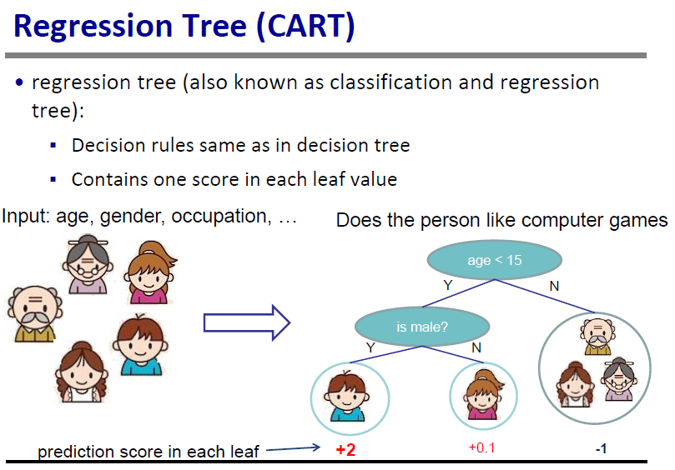

Slide 14
Outline
Review of key concepts of supervised learning
Classification & Regression Tree
Ensemble learning, Random Forest & AdaBoost
Gradient Boosting(GBRT)
GBRT in action
Summary

Slide 15
Ensemble learning
Bagging（Random Forest）
Boosting（AdaBoost，GBRT）

Slide 16
Random Forest
1.两个随机选择
2.特征选择（基于OOB误分率的增加量基于分裂时的GINI下降量）
优点：
适用于高维特征数据，
不需要做特征选择，
并行化，
不易过拟合

Slide 17
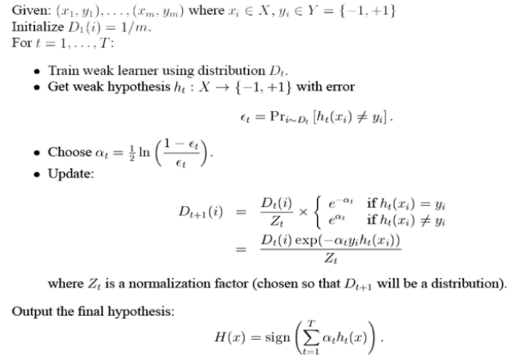
AdaBoost：同样不用做特征筛选

Slide 18
Outline
Review of key concepts of supervised learning
Classification & Regression Tree
Ensemble learning, Random Forest & AdaBoost
Gradient Boosting(GBRT)
Xgboost in action
Summary

Slide 19
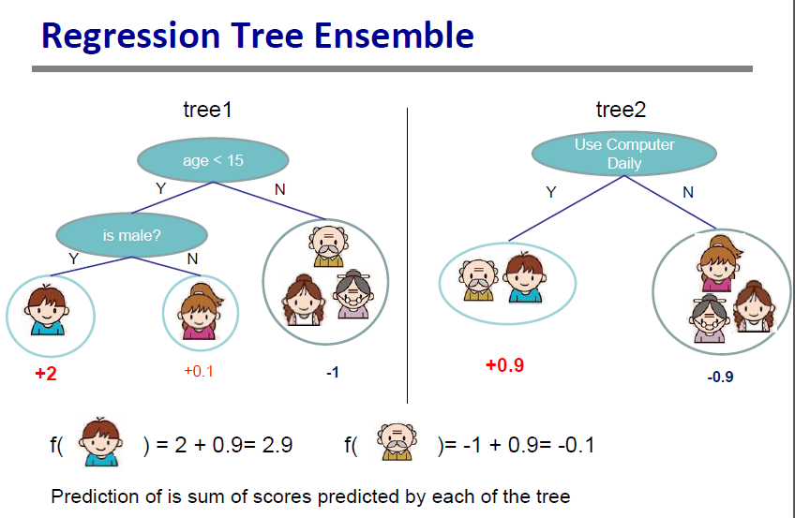

Slide 20
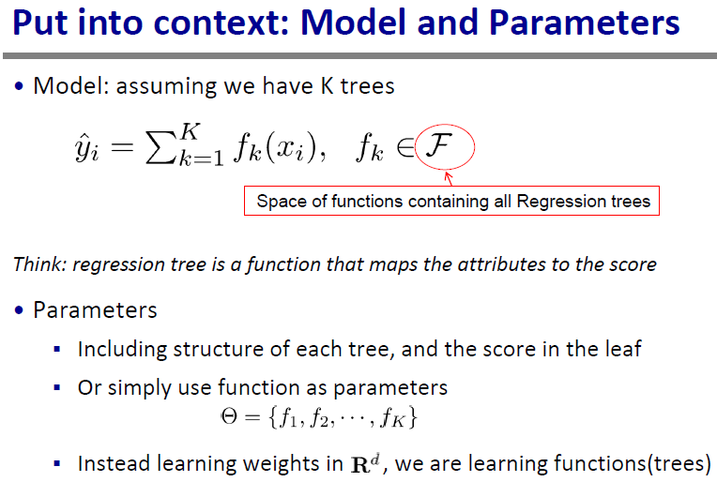

Slide 21
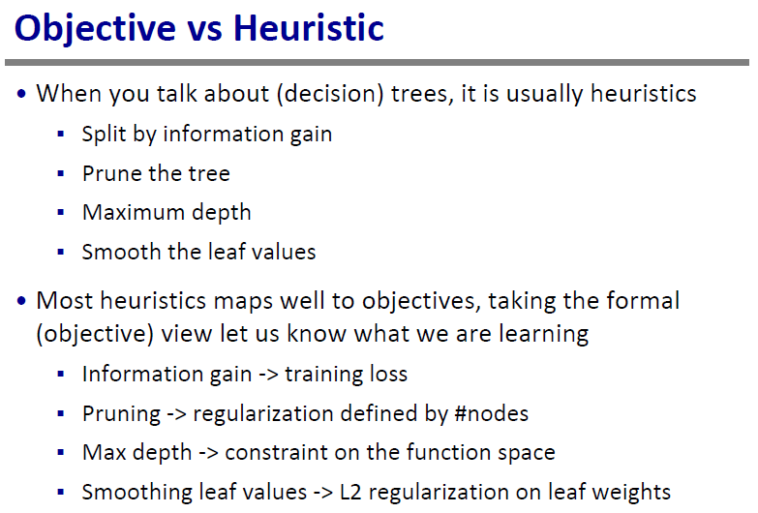

Slide 22
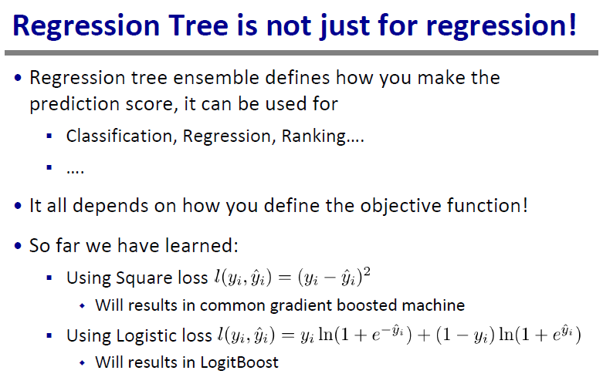

Slide 23
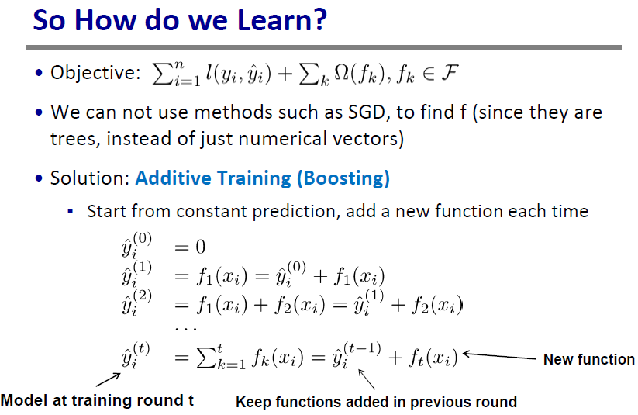

Slide 24
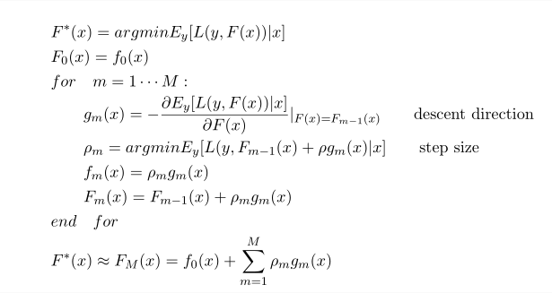
Classic GBRT

Slide 25
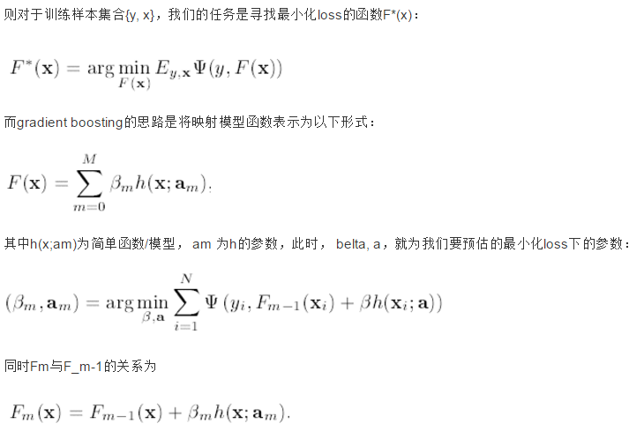

Slide 26
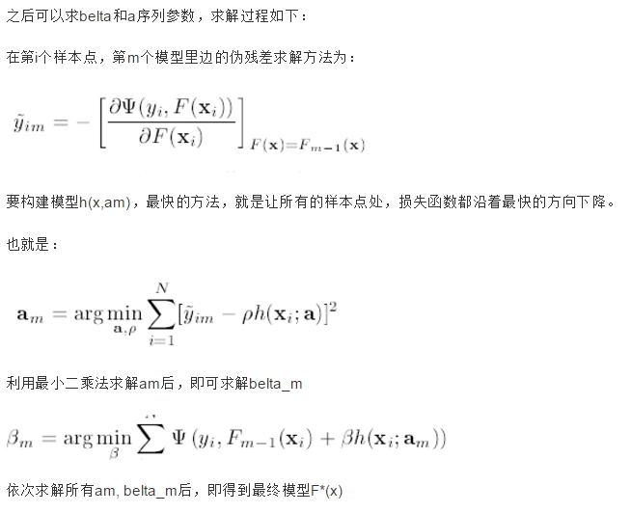

Slide 27
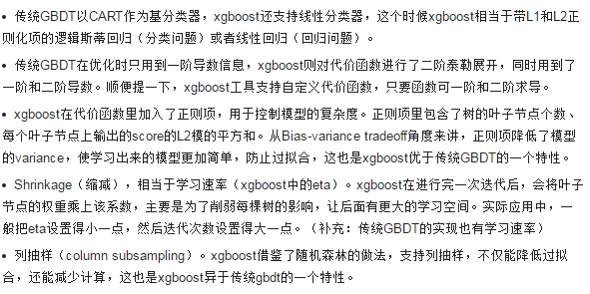
xgboost

Slide 28
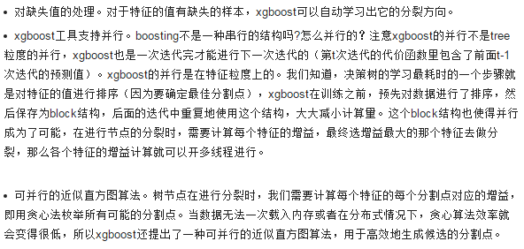
xgboost

Slide 29
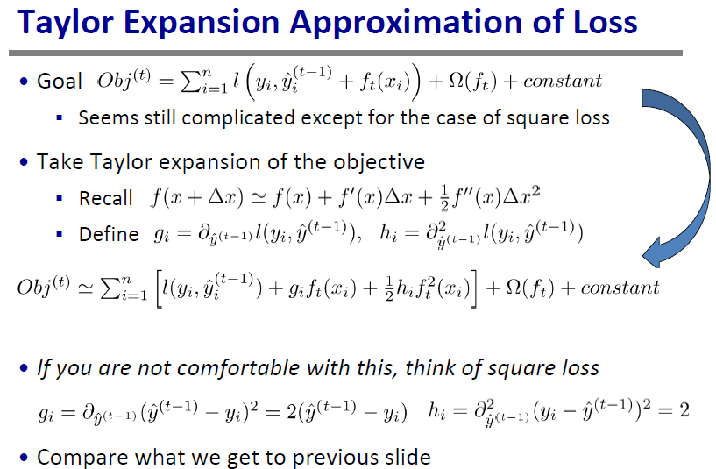

Slide 30
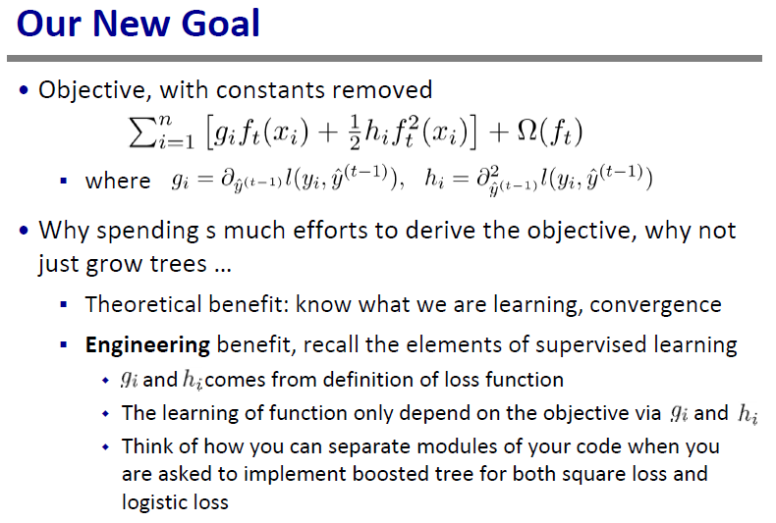

Slide 31
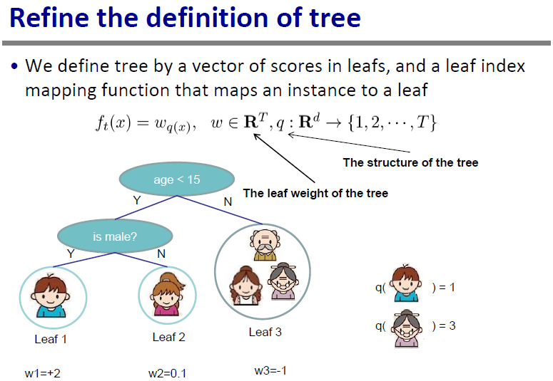

Slide 32
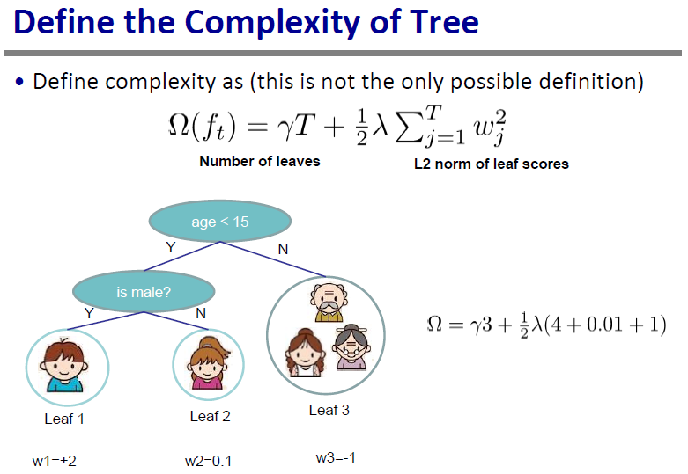

Slide 33
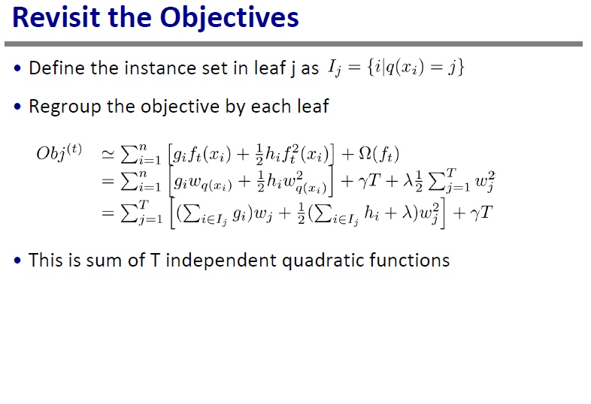

Slide 34
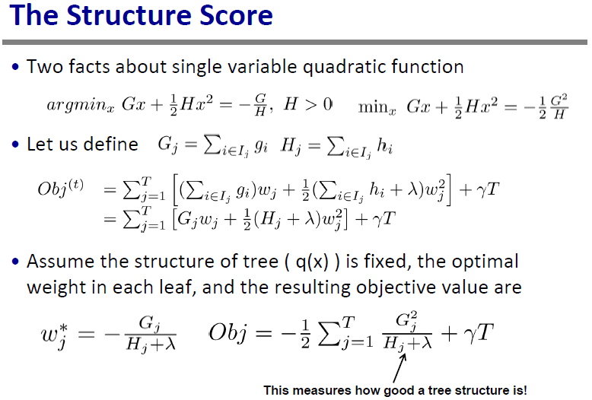

Slide 35
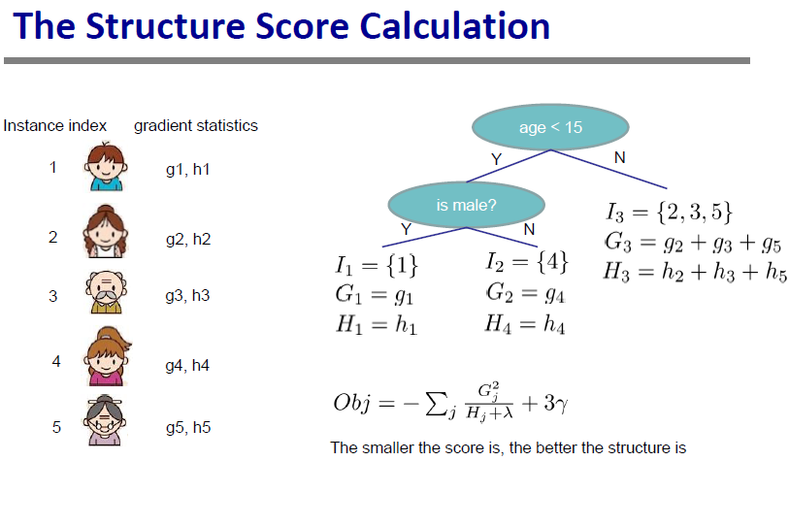

Slide 36
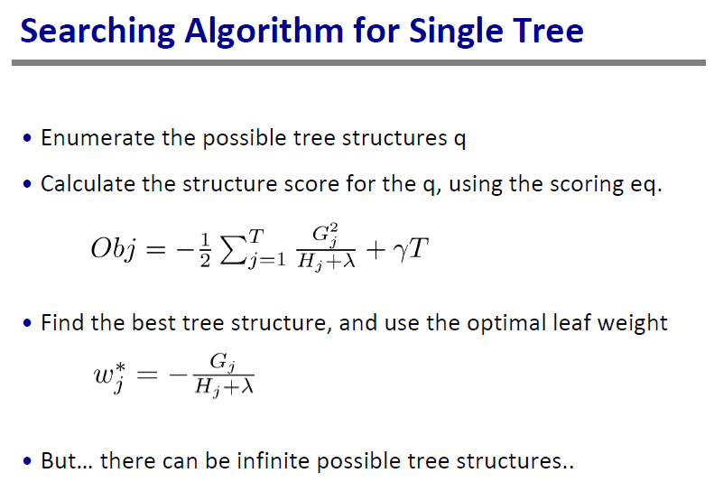

Slide 37
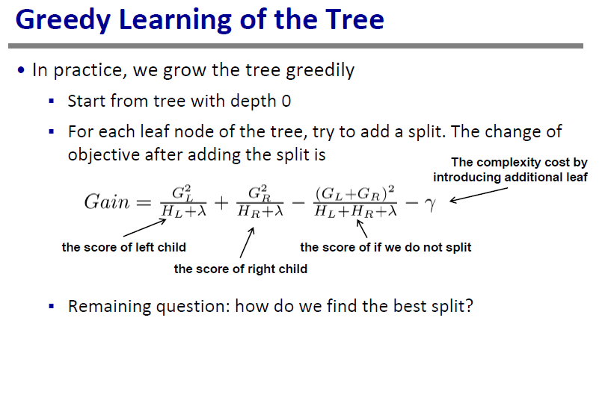

Slide 38
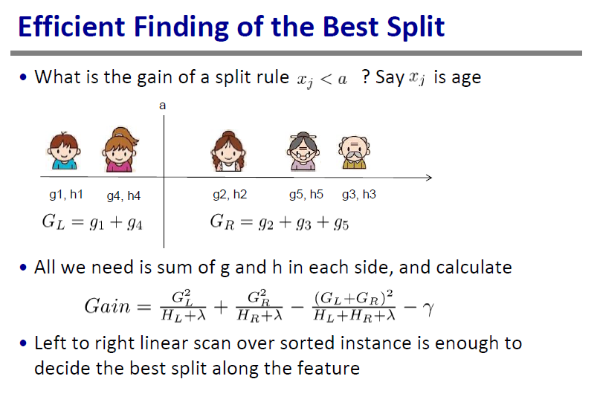

Slide 39
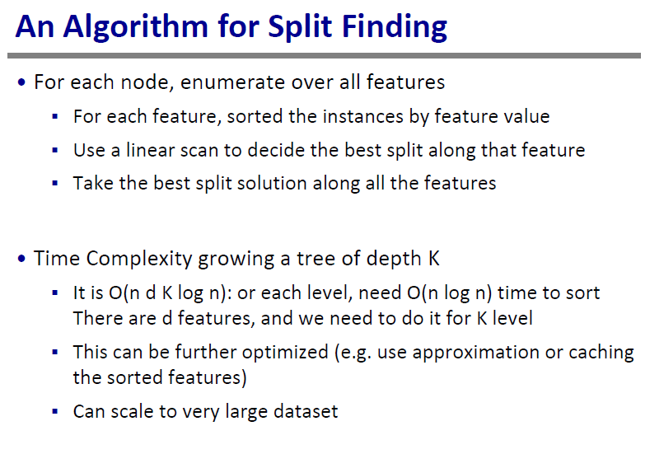
Notes:
回归树在于每个特征切分点的选取，大于多少小于多少 不用Gini系数了

Slide 40
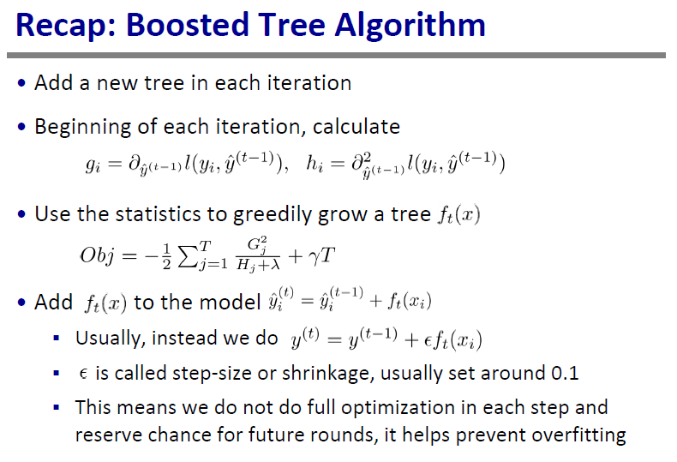

Slide 41
Outline
Review of key concepts of supervised learning
Classification & Regression Tree
Ensemble learning, Random Forest & AdaBoost
Gradient Boosting Machine
GBRT in action
Summary

Slide 42
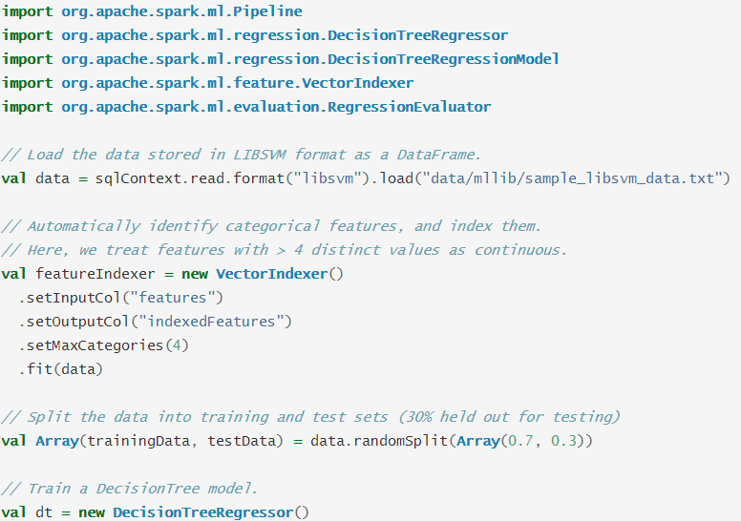

Slide 43
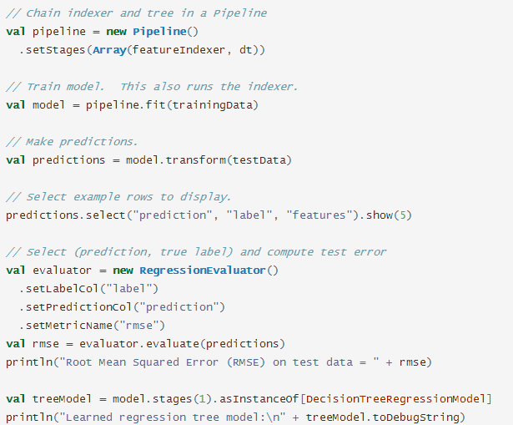

Slide 44

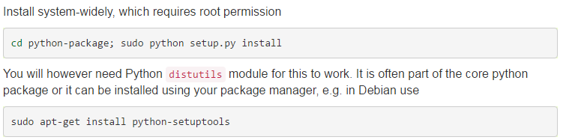
xgboost

Slide 45
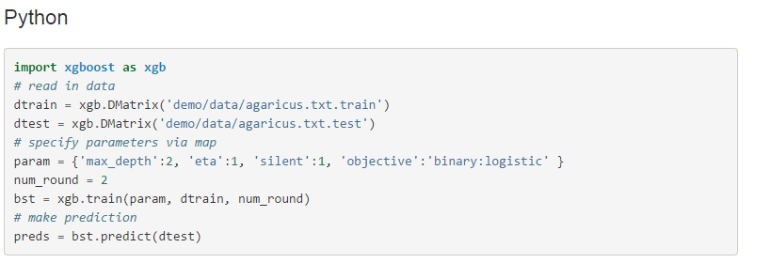

Slide 46
Summary
key concepts of supervised learning
Classification & Regression Tree
Ensemble learning, Random Forest & AdaBoost
Gradient Boosting Machine
GBRT in action

